Slide 1




Mahmoud M. Awali @0xAwali
Javascript
secretKEY - Endpoints - Subdomains

Slide 2






Workflow Of Javascript Files
attacker
JS URLs Monitoring
Secret Keys
Subdomains
Endpoints
Host
JS Files

Slide 3


Note
When Parsing JS For Endpoints , Please Keep Your Eyes Open
Tweet
/ Root Directory
. This Location
.. Up A Directory
./ Current Directory
../ Parent Of Current Directory
../../ Two Directories Backwards

Slide 4
My Methodology
attacker
Try To Extract All The Javascript Files From A Set Of Given Urls By Using Tools e.g. getJS
root@mine:~#./getJS --complete --header "Auth: token" --input domains.txt --output out.txt
" --complete " Complete The URLs e.g. https://www.company.com/api/file.js
" --header "Auth: token" " Custom Request Header
" --input domains.txt " Input File With URLs
" -output output.txt " The File Where To Save The Output

Slide 5
My Methodology
attacker
Try To Extract All The Javascript Files From A Set Of Given Urls By Integration Tools e.g. gau AND subJS
root@mine:~#cat domains.txt | gau -subs | subjs -ua "Value-User-Agent-Header" | tee -a out.txt
" jau -subs " Fetches URLs From AlienVault's And Wayback Machine Include Subdomains Of Target
" -ua "Value-User-Agent-Header" " Value Of User-Agent Header To Send In Requests
" | tee -a out.txt " Save The Output

Slide 6
My Methodology
attacker
Try To Extract All The Javascript Files From A Set Of Given Urls By Using One-Liner Command e.g. Integration Tools e.g. gospider , httpx , subJS AND anew
Tweet
Steps to produce :-
1 - Open Your Terminal
2 - Write This Command
xargs -I@ -a domains.txt -P10 sh -c 'gospider -a -d 4 -t 3 -c 50 -s @ | tr "[] " "\n" | grep -oE "(/\*([^*]|(\*+[^*/]))*\*+/)|(.*)|(//.*)" | httpx -silent -threads 200 | subjs -c 100 -t 5 | anew subjsUrls'

Slide 7
My Methodology
attacker
Try To Extract All The Endpoints From Javascript URL OR File By Using Tools e.g. LinkFinder
root@mine:~#cat extractEndpoints.sh #!/bin/bash
for jsFile in `cat out.txt`
do
Python3 linkfinder.py -o cli -i $jsFile | tee -a newEndpoints.txt
done
root@mine:~#chmod +x extractEndpoints.sh && ./extractEndpoints.sh
" -o cli " Print Output to STDOUT " " -i urlJS OR out.txt " Input a Javascript URL OR File

Slide 8
My Methodology
attacker
Try To Extract All The Endpoints From Javascript URL OR File By Integration Tools e.g. subJS AND JSA
root@mine:~#cat domains.txt | subjs -ua "Value-User-Agent-Header" | python3 jsa.py -e -v
" -ua "Value-User-Agent-Header" " Value Of User-Agent To Send In Requests
" -e " Exclude 3rd Party JS Files
" -v " Verbose Mode

Slide 9
My Methodology
attacker
Try To Extract All The Endpoints From Any Domain By Using One-Liner Command e.g. One Of Those Commands
Tweet
Steps to produce :-
1 - Open Your Terminal
2 - Write This Command
curl -L -k -s https://www.comapny.com | tac | sed "s#\\\/#\/#g" | egrep -o "src['\"]?\s*[=:]\s*['\"]?[^'\"]+.js[^'\"> ]*" | awk -F '//' '{if(length($2))print "https://"$2}' | sort -fu | xargs -I '%' sh -c "curl -k -s \"%\" | sed \"s/[;}\)>]/\n/g\" | grep -Po \"(['\\\"](https?:)?[/]{1,2}[^'\\\"> ]{5,})|(\.(get|post|ajax|load)\s*\(\s*['\\\"](https?:)?[/]{1,2}[^'\\\"> ]{5,})\"" | awk -F "['\"]" '{print $2}' | sort -fu
Tweet

Slide 10
My Methodology
attacker
Try To Extract All The Endpoints From Any Javascript File By Integration Tools e.g. js-beautify AND CyberChef
Tweet
Steps to produce :-
1 - Open Your Terminal
2 - Write This Command
wget https://www.comapny.com/app.js
js-beautify file.js > pretty.js
3 - Copy Content Of pretty.js To CyberChef

Slide 11
My Methodology
attacker
Try To Extract All Subdomains From Any Domain By Using Tools e.g. subscraper
root@mine:~#python3 subscraper.py -u URL -v -o output.txt
" -u URL " URL Of Target e.g. https://www.company.com
" -v " Enables Verbosity
" -o output.txt " File Where To Save Subdomains

Slide 12
My Methodology
attacker
Try To Extract All The Endpoints And Subdomains From Any Domain By Using Tools e.g. JSFinder
root@mine:~#python3 JSFinder.py -u URL -c "COOKIE-Value" -d -ou url.txt -os subdomains.txt
" -u URL " URL Of Target e.g. https://www.company.com
" -c "COOKIE-Value" " Value Of Cookie Header To Send In Requests
" -d " Rescan Every URL You Will Find It aka Deep Find
" -ou url.txt " File To Save Paths " -os subdomains.txt " File To Save Subdomains

Slide 13
My Methodology
attacker
Try To Scan Javascript URL File To Extract Tokens By Using Tools e.g. SecretFinder
root@mine:~#python3 SecretFinder.py -i out.txt -H 'Header: Value' -o secrets.txt
" -i out.txt " Input a Javascript URL From out.txt
" -H 'Header: Value' " Custom Request Header
" -o secrets.txt " Save Output To secrets.txt

Slide 14
My Methodology
attacker
Try To Scan Javascript URL File By Using Tools e.g. JScanner
root@mine:~#cat out.txt | JScanner --- -o scan.txt -t 10
" --- " Input a Javascript URL From STDIN
" -o scan.txt " Save Output To scan.txt
" -t 10 " Number Of Threads

Slide 15
My Methodology
attacker
Try To Analyze Javascript Files From Your Command Line e.g. js-beautify file.js > pretty.js && grep -Eo "(http|https)://[a-zA-Z0-9./?=_-]*" pretty.js | sort -u
Tweet
Steps to produce :-
1 - Open Your Terminal
2 - Write This Command
wget https://www.comapny.com/app.js
js-beautify file.js > pretty.js
grep -Eo "(http|https)://[a-zA-Z0-9./?=_-]*" pretty.js | sort -u

Slide 16


My Methodology
attacker
Try To Search For Javascript Manually To Discover New parameters , Endpoints And Subdomains OR References To More API Calls OR Get Dev Comments OR Tokens
Video
Steps to produce :-
1 - Browse Your Target e.g. https://www.company.com 2 - Click Right , Choose View Page Source
3 - Press Ctrl Plus F To Display Search Box
4 - Search For Javascript Files e.g. .js
5 - Search For Certain Keywords e.g.
api , internal , url: , token , var = , // , https:// , company.com , parameter etc
Writeup
Writeup

Slide 17
Top 15 DOM Base Open URL Parameter
attacker
location
location.host
location.hostname
location.href
location.pathname
location.search
location.protocol
location.assign()
location.replace()
open()
domElem.srcdoc
jQuery.ajax()
$.ajax()
XMLHttpRequest.open()
XMLHttpRequest.send()
Tweet

Slide 18
My Methodology
attacker
Try To Execute Those Functions That Contains Sensitive Keywords e.g. key , API Key etc In Your Browser's Console To See What They Do
Tweet
Steps to produce :- 1 - Browse Your Target e.g. https://www.company.com 2 - Click Right , Choose View Page Source
3 - Search For Functions That Contains Certain Keywords e.g. api , internal , url: , var = , // , https:// , company.com , parameter etc
4 - Click Right , Choose Inspect Element (Q)
5 - Click Console , Write Your Funcion e.g.
secret() Then Press Enter

Slide 19
My Methodology
attacker
Try To Monitor Specific Javascript URL To Get Notification On Slack OR Telegram If There Are Changes By Using Tools e.g. JSMon
Steps to produce :- 1 - Open File .bashrc 2 - Write Those
export JSMON_NOTIFY_SLACK=True
export JSMON_SLACK_TOKEN=token
export JSMON_SLACK_CHANNEL_ID=channel
3 - Open Your Terminal
2 - Write This Command
source .bashrc
cd path/to/jsmon/tool
crontab -e && @daily jsmon.sh
echo "https://www.company.com/file.js" >> targets/company.com
python3 jsmon.py

Slide 20
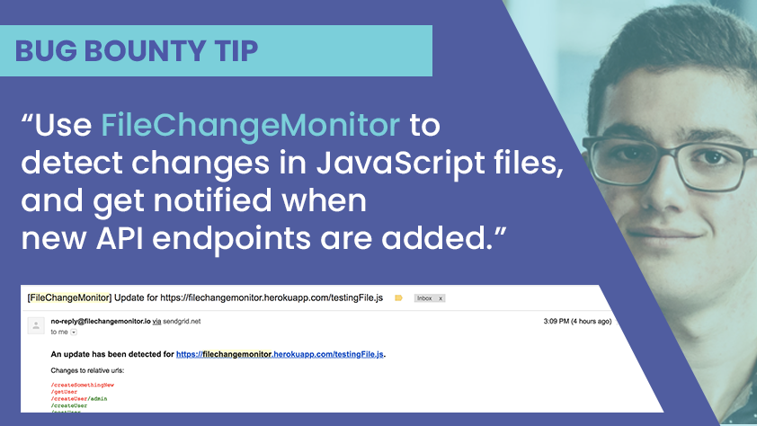
My Methodology
attacker
Try To Use FileChangeMonitor To Monitor JavaScript Files And Discover Endpoints When They're Added
Tweet
Tweet

Slide 21
Mahmoud M. Awali @0xAwali
Thank You

